Slide 1

Notes:
Esther

Slide 2
Have you ever shopped with just your eyes in hopes one day you’ll be able to buy that product? In retail that’s called visual merchandising, the art of displaying the products, in a way that make people want to buy them. Looking at today’s society, you can browse for clothes, accessories, technology, etc. but why can’t we browse for cars? Classic cars, to be specific.
Through Classic Whipz you can now browse through classic cars that one day could be yours!
“
”
Notes:
Elevator Pitch
Esther

Slide 3


Classic Whipz is a car e-commerce site that allows you to buy and sell classic cars. The site contains cars that are labeled vintage to newly classic ones. The process is once the buyer selects to buy, they pay 10% of the car value then it the connects the buyer to the seller. Both the buyer and the seller agree on a rendezvous and the trade is made.
Notes:
Description of Classic Whipz
Esther

Slide 4


Few to no e-commerce sites for classic cars
Cons
Classic cars are deemed expensive and luxurious to buy so discourages buyers
Only Google images are available to view classic cars
An e-commerce site that users can sell, buy and comment on
Pros
Easy access to view rare classic cars
Encourages and motivates buyers
Allows sellers to sell safely with the 10% deposit fee
Notes:
Motivation for development
Problem vs Solution
Cons vs Pros
Esther

Slide 5
User Story
AS A car connoisseur,
I WANT TO buy a classic car,
SO THAT I can start/add (it to) my car collection
AS A car owner,
I WANT TO sell my classic car,
SO THAT I can buy a new car/buy another valuable product
Notes:
User Story
Esther

Slide 6
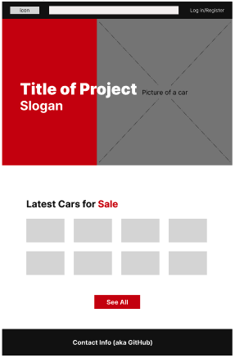
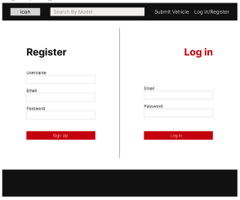
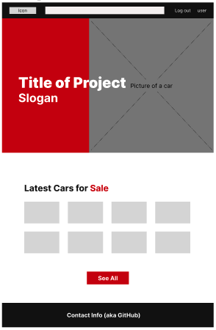
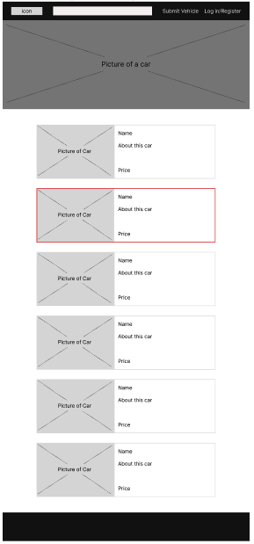
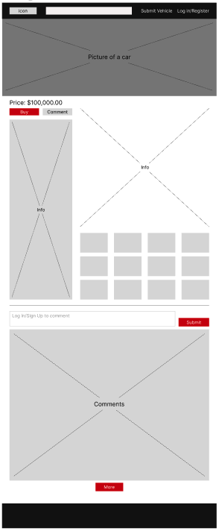
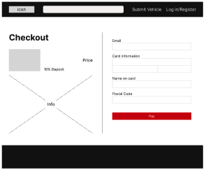
Wireframe (Figma)
Notes:
Wireframe using Figma
Hovig

Slide 7

New Technology Used
Stripe is a payment processing platform that allows users to pay using credit, debit cards, and other payments as well. It’s quick and secure payment processing was one of the reasons why we chose Stripe over other platforms.
Stripe provided APIs for developers to use. There were two features, the test feature as and the live feature. The test feature is more for developers to test the API with their own codes and when ready to deploy, the live feature is used.
Stripe
https://stripe.com/docs/development
Notes:
Hovig

Slide 8
Tasks
Hovig
Create the overall folder structure
Research about Stripe (payment method)
Implement Strip to the code (API key)
Deploy database to Heroku
Helped create README file
Cezar
Create the handlebars
Create the seeds
Insert images and other databases
Create the routes
Connect server-side, middleware and public files
Build the overall skeleton of the website
Esther
Create Wireframe using Figma
Create models
Create logos and icons
Polish overall UI using CSS & made website responsive
Create presentation slideshow
Helped create README file
Notes:
Tasks
Hovig

Slide 9
Challenges
Successes
Implementing Stripe into the code
Using API keys
Installing stripe packages
Testing Stripe to see if the code works
Creating multiple handlebars which leads to multiple functions and callbacks
Making the whole website responsive
Deploying to Heroku
Deploying all the database
Overall layout of the application
Division of roles
Communicating frequently about updates and pull requests
Inserting problems in the repository and clearing the problems one by one
Notes:
Cezar

Slide 10
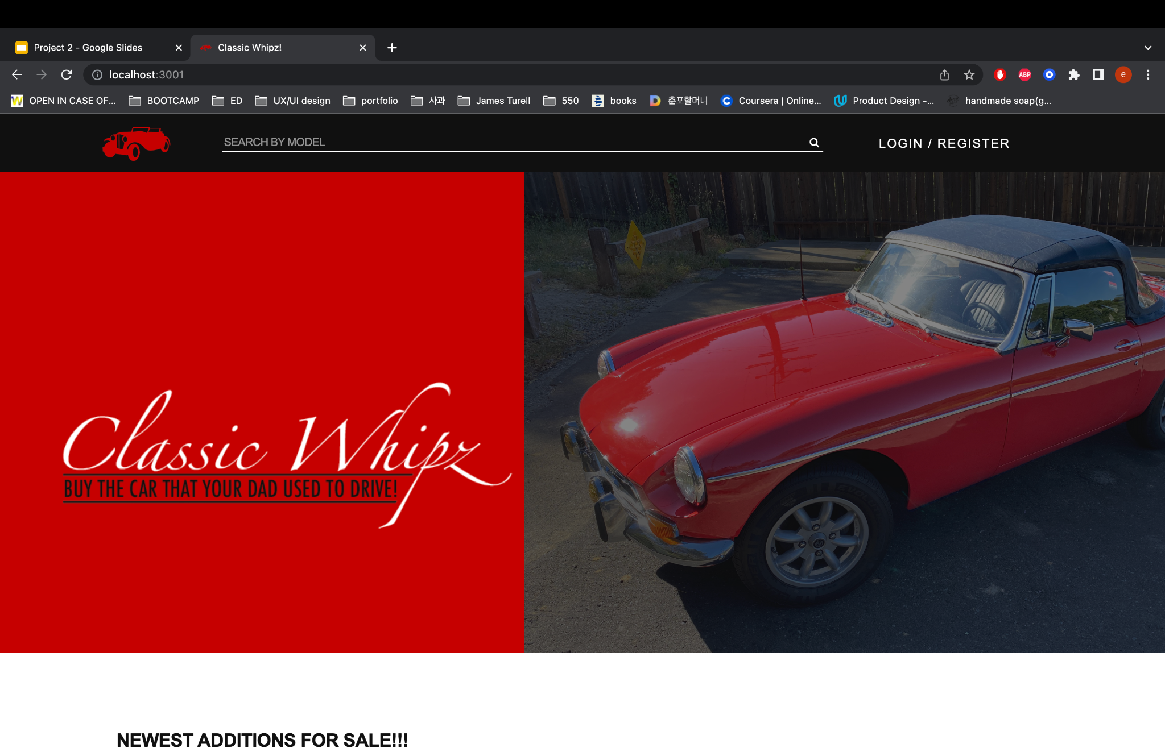
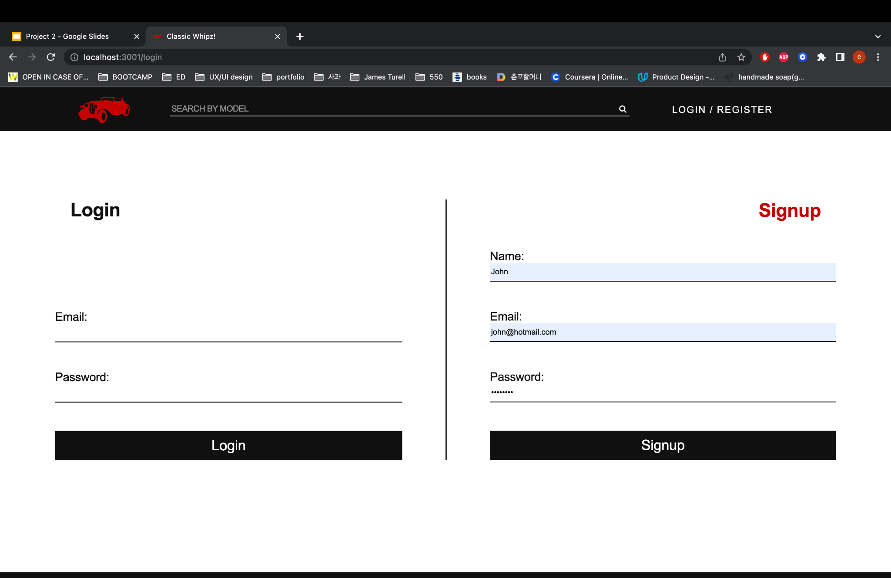
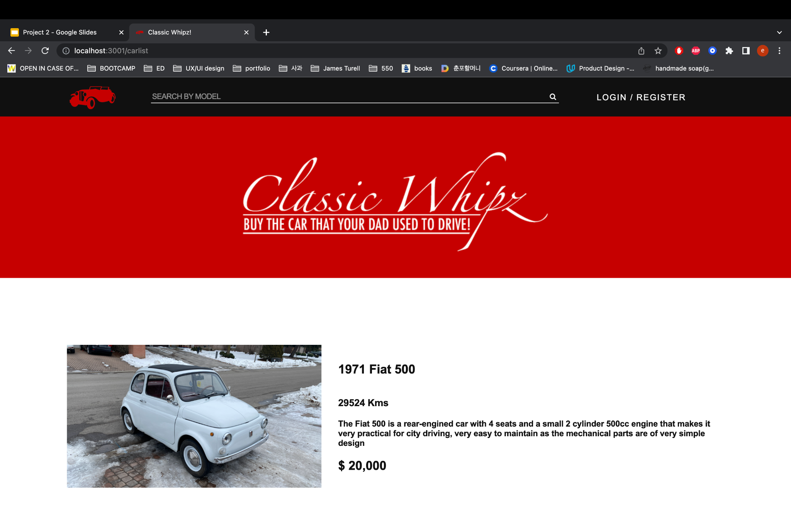
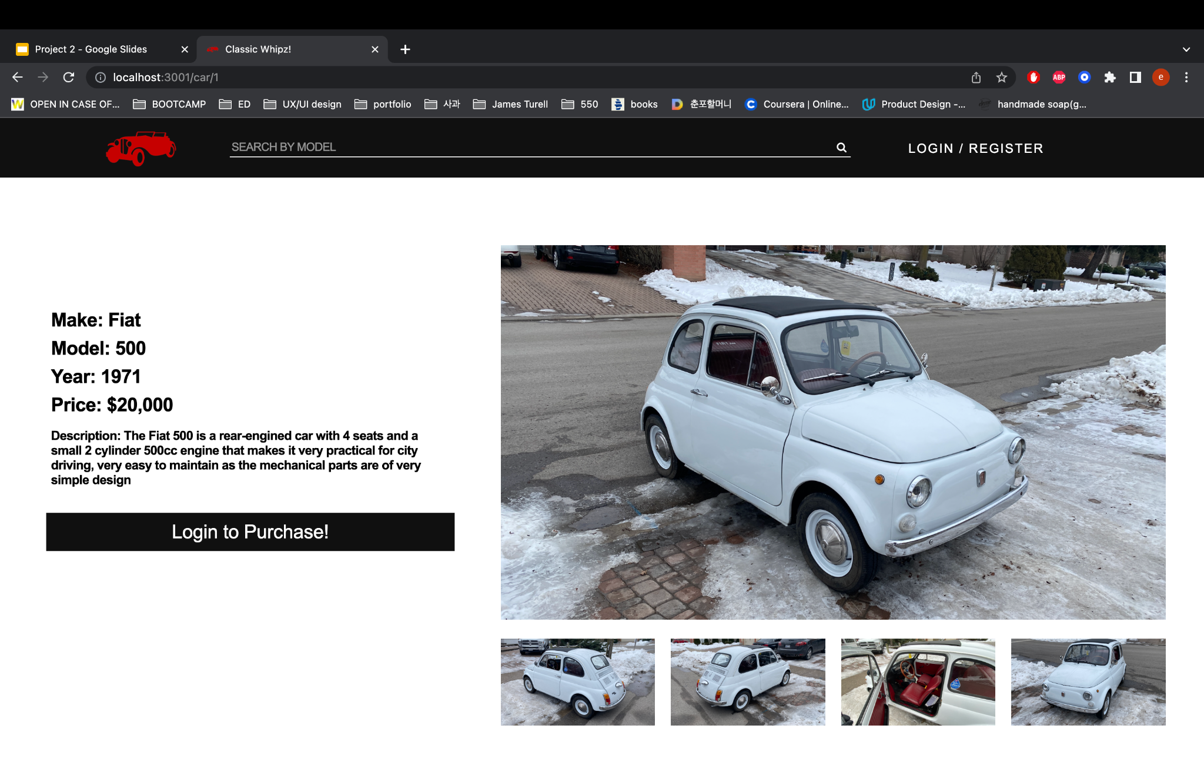
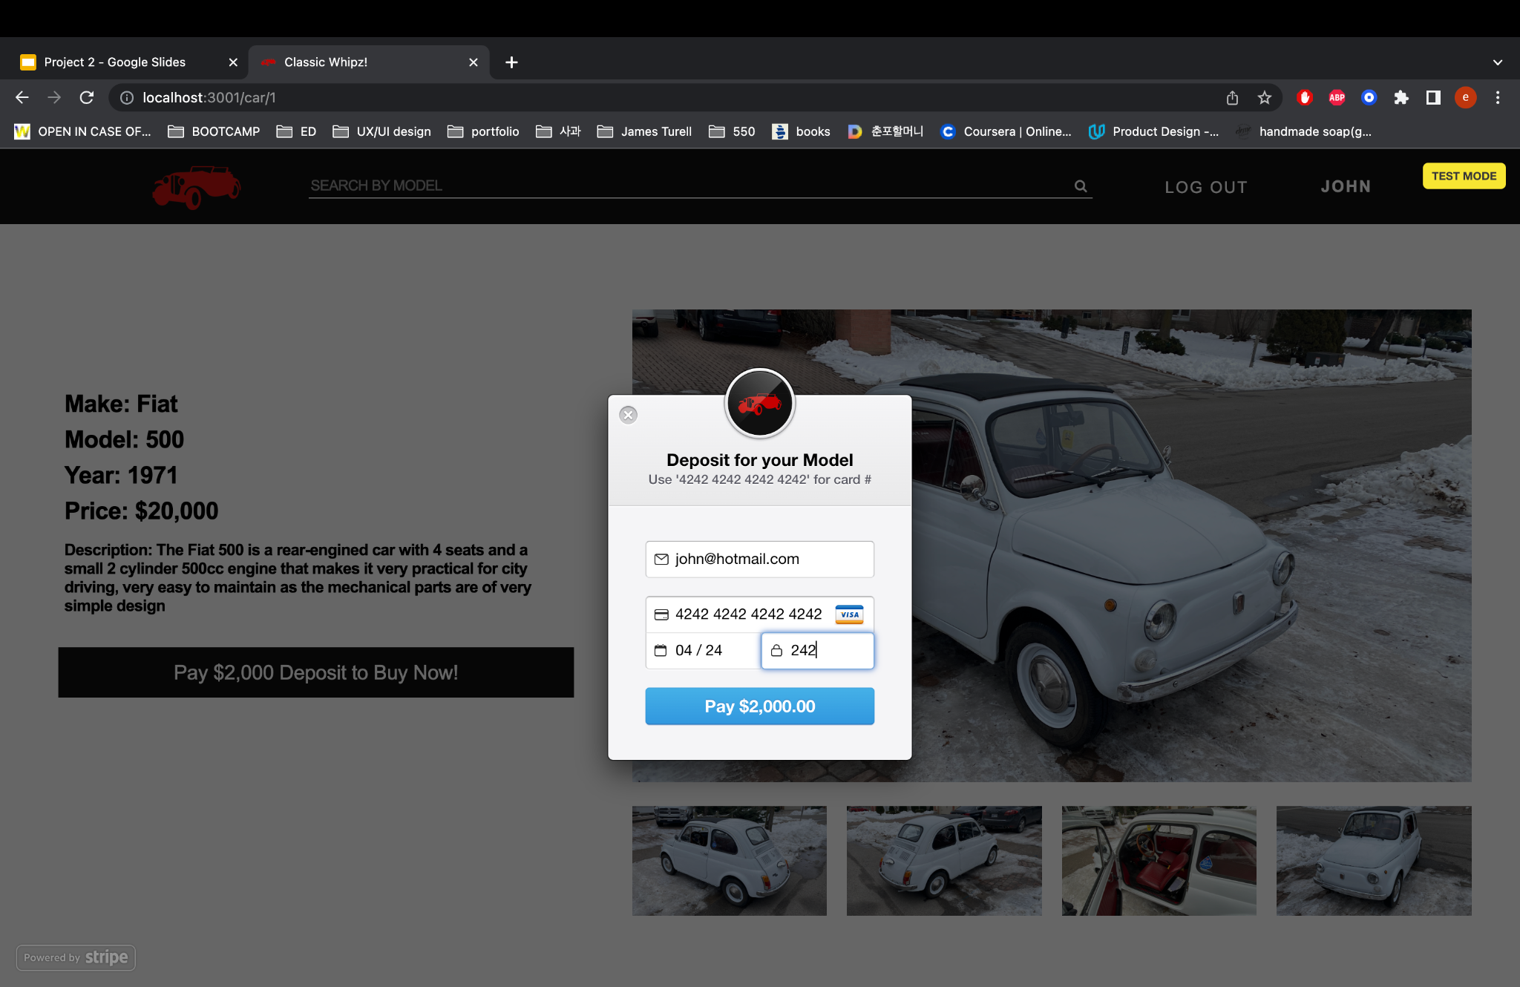
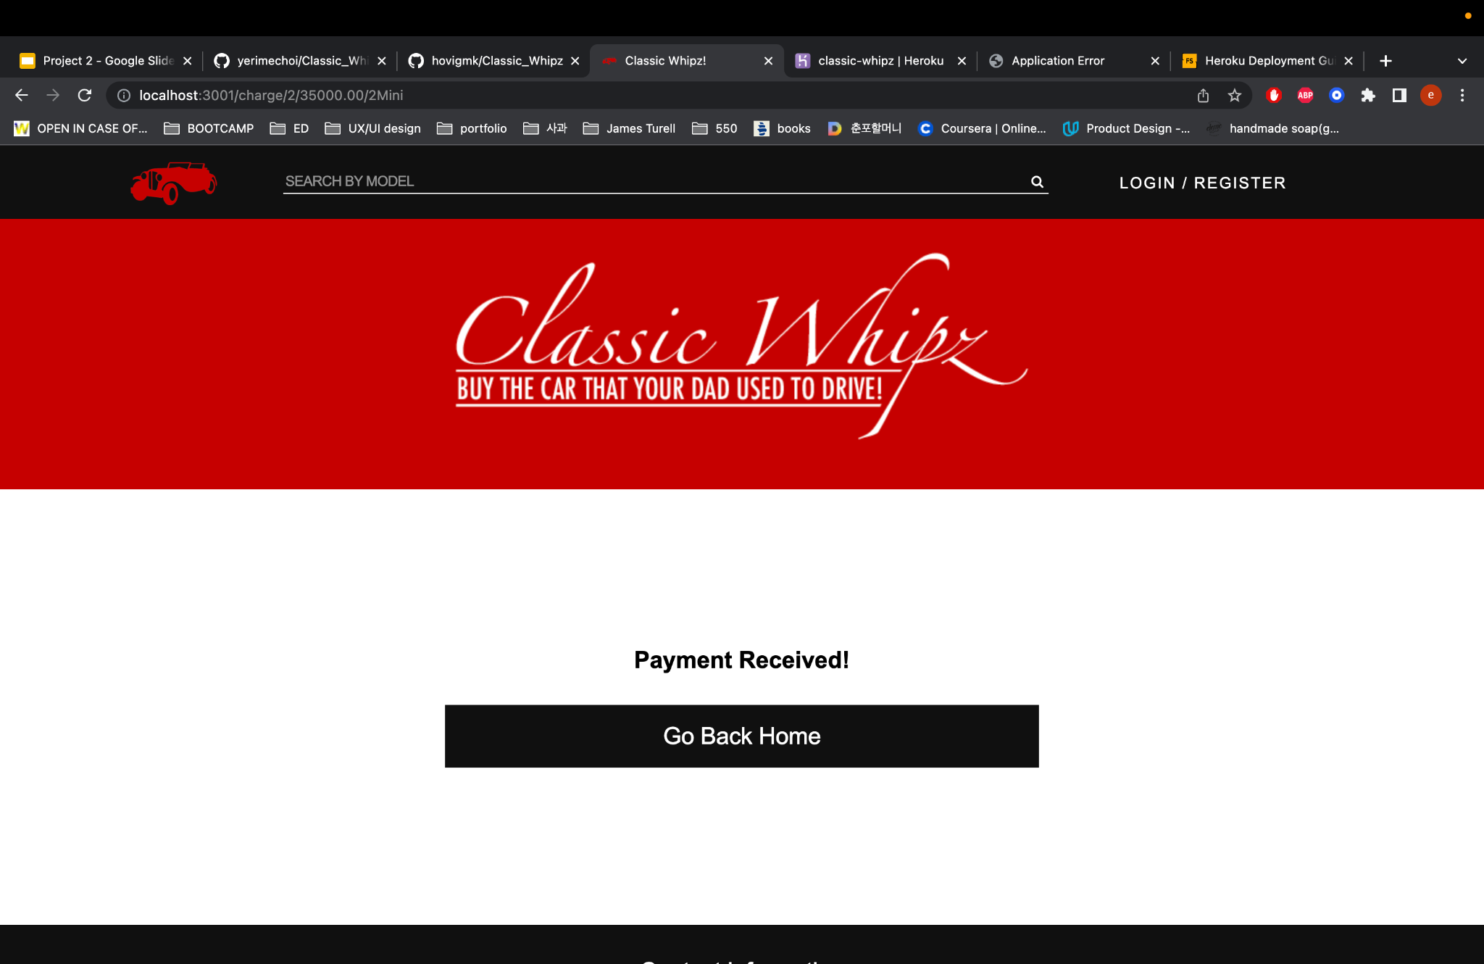
Demo
Notes:
Cezar

Slide 11

Due to the multiple possibilities of development, we had to scale down the project to be able to fit it into the given time span. Therefore, some future developments would be:
Requesting the ability for users to upload and sell their own classic cars
Inserting images, description, price, etc.
Through thorough examination by evaluator
Customizing Stripe to fit in with the overall design hierarchy of the website
Next steps of once the user pays the 10% deposit
Creating a chat system for users to get in contact with the seller
Linking banking information or other possible ways to figure out the progress/status
Being able to delete the cars once purchase is processed
Next steps would be to create an app that you can download
Notes:
Because the project contains a lot of possibilities of development, we had to scale down the project to fit the key important parts to showcase with the given time.
Cezar

Slide 12


Links
Heroku
https://classiccarswebsite.herokuapp.com/
GitHub
https://github.com/hovigmk/Classic_Whipz
Notes:
Hovig

Slide 13
Contributors
Hovig Kalayjian
@hovigmk
Cezar Amaral
@cdennis27
Esther Choi
@yerimechoi
Notes:
Hovig

